Slide 1
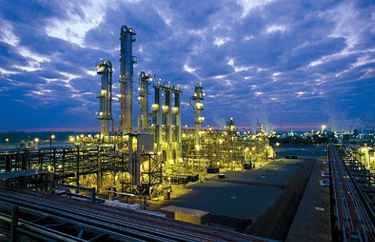
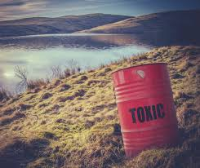

TOXIC CRUSADERS
CSC 495 Project - Fall 2017
Aaron Denton Jacob Durham Swetha Polisetty Melvin Watlington

Slide 2
Project Goals
Explore Toxics Release Inventory (TRI) and Zillow Home Value Index (ZHVI) data.
Find trends in these data that reveal the nature of industrial production and the effect it has on communities.
Visualize changes over the last 20-30 years in both industrial chemical emission and house values.
Compare the house prices and the impact of proximity of industries to the houses.

Slide 3
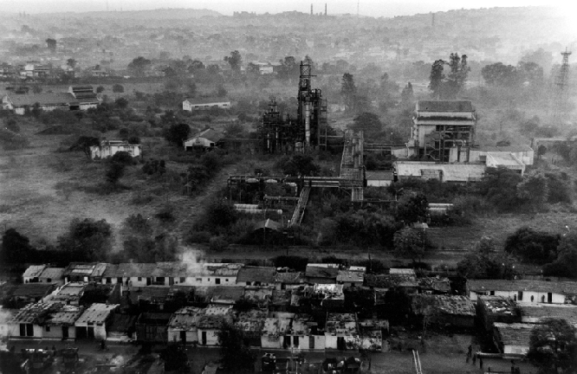
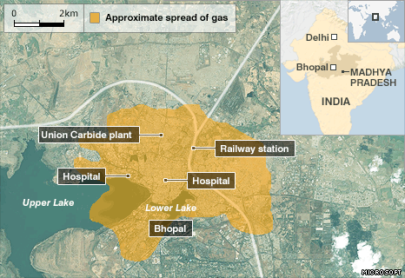
Toxics Release Inventory
History
From the EPA:
“On December 4, 1984, a cloud of extremely toxic methyl isocyanate gas escaped from a Union Carbide Chemical plant in Bhopal, India. Thousands of people died that night… considered to be the worst industrial disaster in history. Thousands more died later… survivors continue to suffer with permanent disabilities. In 1985, a serious chemical release occurred at a similar plant in West Virginia.
In 1986, Congress passed the Emergency Planning and Community Right-to-Know Act (EPCRA) to support and promote emergency planning and to provide the public with information about releases of toxic chemicals in their community. Section 313 of EPCRA established the Toxics Release Inventory.”

Slide 4
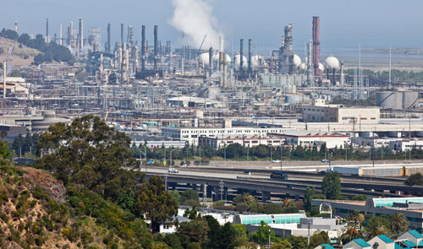
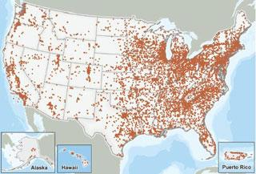
Toxics Release Inventory
Data Sets
The EPA provides data sets containing TRI data for the years 1987 through 2016.
Facilities across many different industrial sectors must submit annual reports of chemicals released to the environment and/or managed through recycling, energy recovery, and treatment.
In this context, “release” of a chemical means that it is emitted to the air or water, or placed in some type of land disposal.

Slide 5
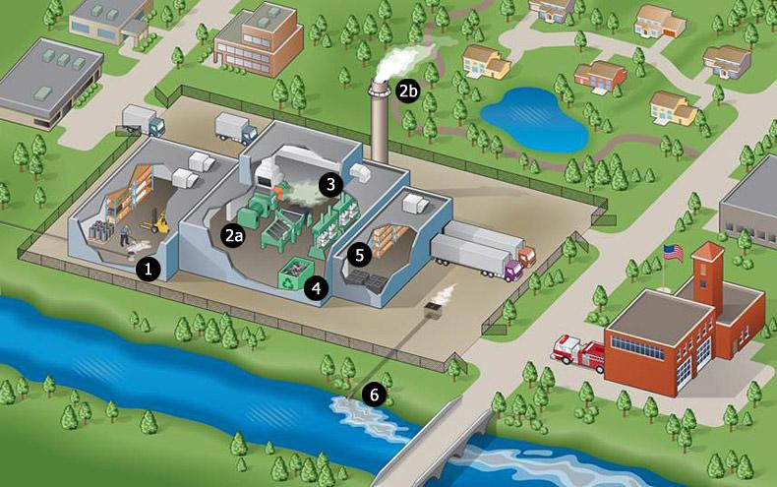
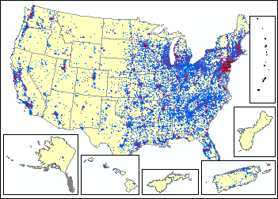
Toxics Release Inventory
Data Sets
Facility Information
Facility Name
Address
Latitude & Longitude Coordinates
SIC codes (4-digit industrial classification)
NAICS codes (6-digit industrial classification)
Industry Sector Codes
(2) Chemical Identification and Classification Information
(3) On-site Release Quantities
(4) Publicly Owned Treatment Works (POTW) Transfer Quantities
(5) Off-Site Transfer Quantities for Release/Disposal and Further Waste Management
(6) Summary Pollution Prevention Quantities

Slide 6


Zillow Home Value Index
Background
Zillow is an online real estate database company, founded in 2006.
They provide many real estate related services, including real estate loan quotes, neighborhood boundary mapping, and home value estimates.
Their home value estimates, called Zestimates, are based on a proprietary algorithm, and serve as the basis of the Zillow data set that we are leveraging for this project.

Slide 7
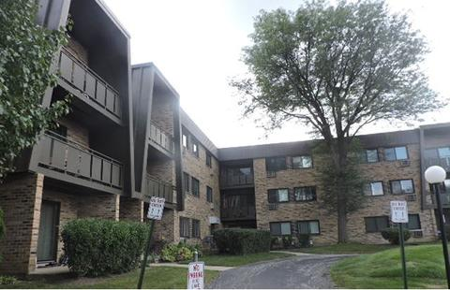
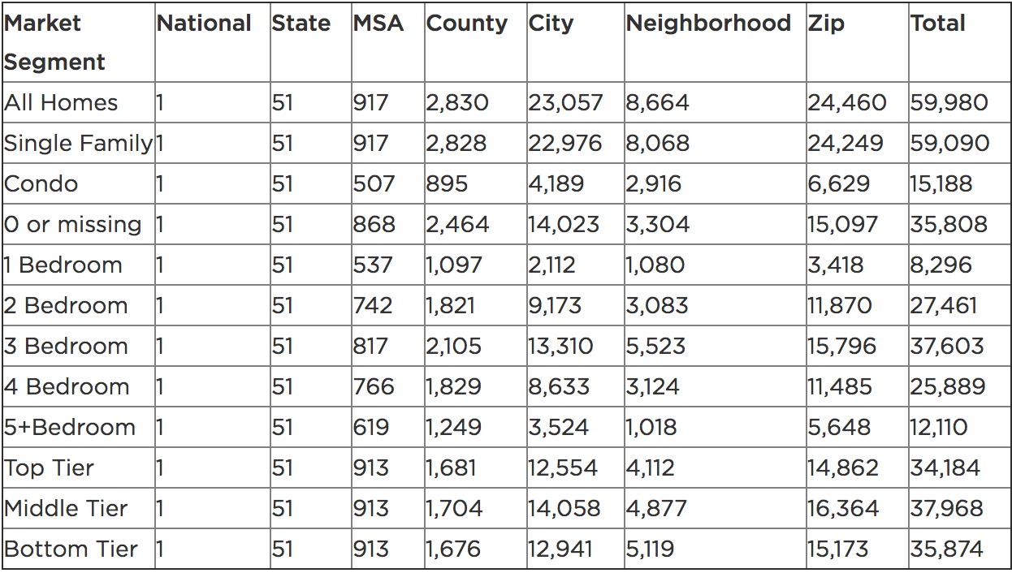
Zillow Home Value Index
Data Sets
Zillow Home Value Index (ZHVI) is a collection of Zestimates, split into 12 market segments.
All Homes
Single Family
Condo
0 or “missing” Bedrooms
1/2/3/4/5+ Bedrooms
Top Tier (among homes in same metro area)
Middle Tier
Bottom Tier

Slide 8

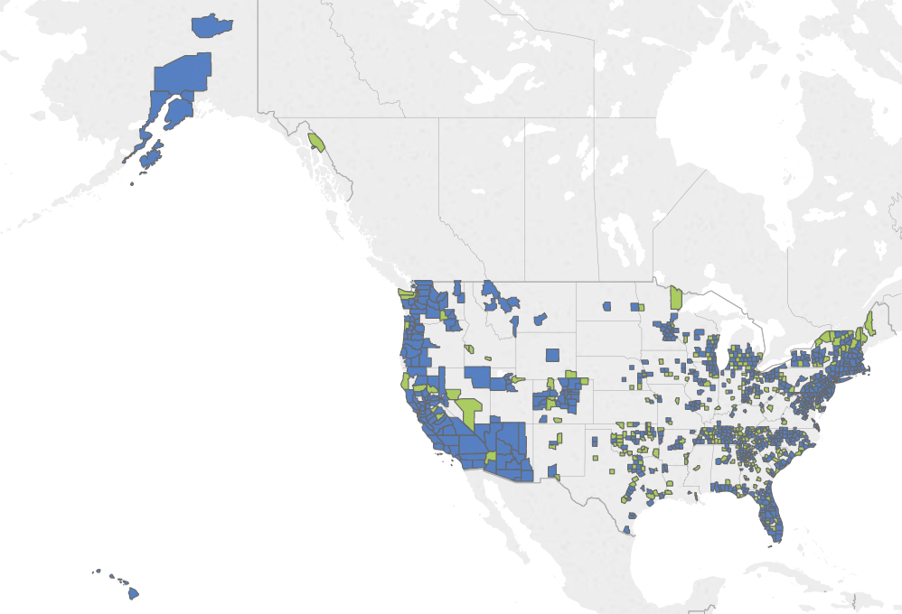
Zillow Home Value Index
Data Sets
Using the Zestimates for residential homes, the ZHVI data is created in a 5 step process:
Calculate Raw Median Zestimates
Adjust for Residual Systematic Error
Apply Henderson Moving Average Filter
Apply Seasonal Adjustment
Final Quality Control
Zillow provides data sets for each market segment, ranging from 1996-2016 (although this data contains lots of gaps for the first few years)

Slide 9
Combining The Data
TRI + ZHVI
Between the TRI and ZHVI data sets, there is a tremendous amount of information to explore.
By comparing ZHVI trends to temporal changes in TRI data, we hope to gain insight on the effect that industrial chemical release might have on home values.
In addition to this combined purpose, there are many interesting questions that we can ask about each data set individually.

Slide 10
Standardizing TRI Data: What Do We Need?
Over 100 columns on attributes, lots of them are irrelevant for our purposes
This includes unwanted Government codes, industry compliance codes, etc
We want location information, chemical information, and release and recycling information
We identified 21 categories, common to US and State data sets, to use
YEAR
FACILITY_NAME
FEDERAL_FACILITY
PARENT_COMPANY_NAME
INDUSTRY_SECTOR
ZIP
STATE
CITY
COUNTY
LATITUDE
LONGITUDE
CHEMICAL
UNIT_OF_MEASURE
CARCINOGEN
CAA_CHEMICAL
TOTAL_RELEASES
ON_SITE_RELEASE_TOTAL
OFF_SITE_RELEASE_TOTAL
ON_SITE_RECYCLED_TOTAL
OFF_SITE_RECYCLED TOTAL
ONE_TIME_RELEASES

Slide 11
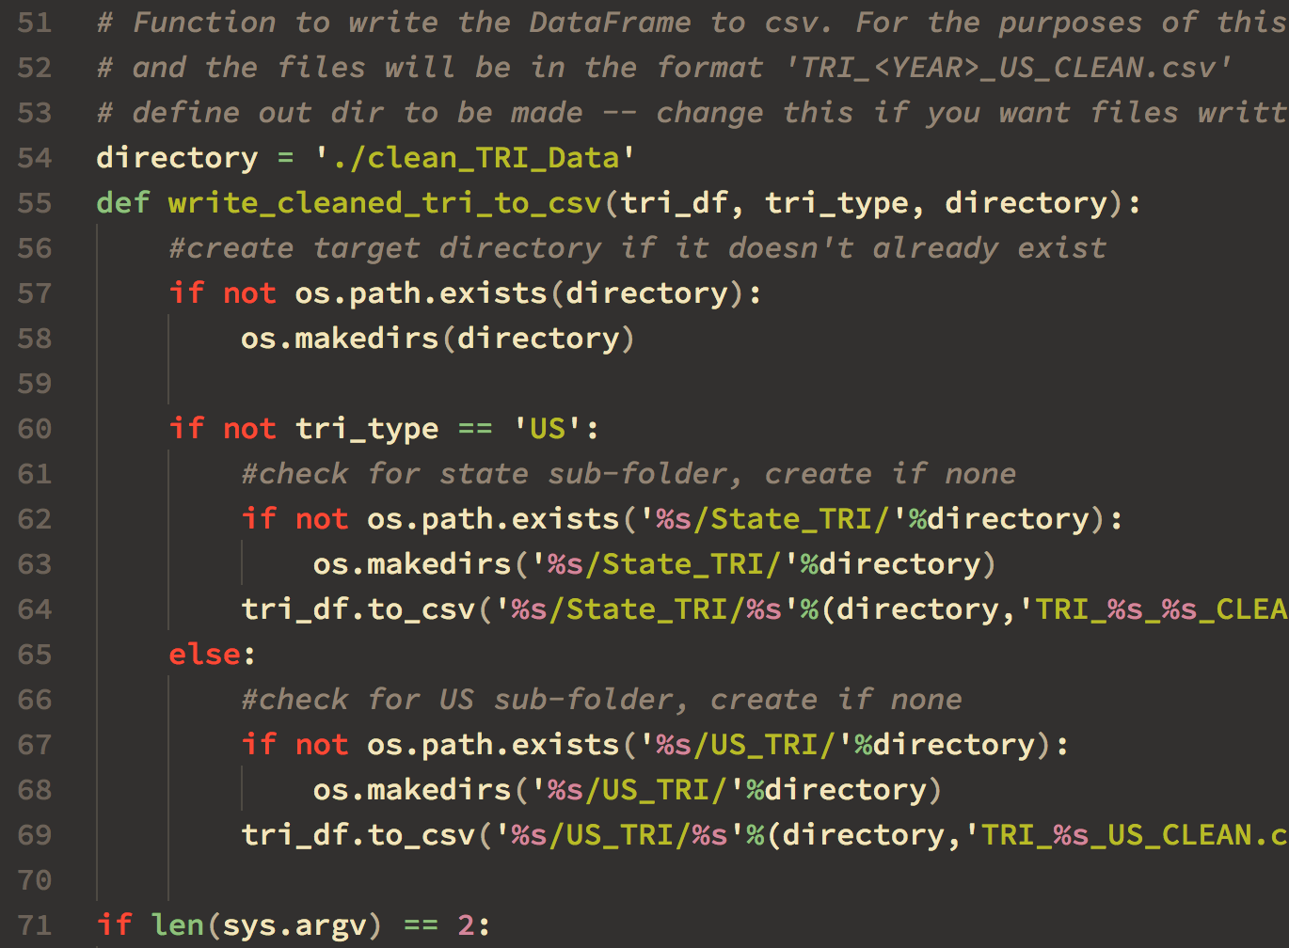
Standardizing Project Data: Cleaning CSV Files
Created Python script to process US and State CSV files
Trims unwanted attributes
Renames columns for standard access
Handles NaN values in numerical columns
Reduces CSV size by ~75%
Run script on downloaded CSV files to pre-clean for use in ipynb

Slide 12
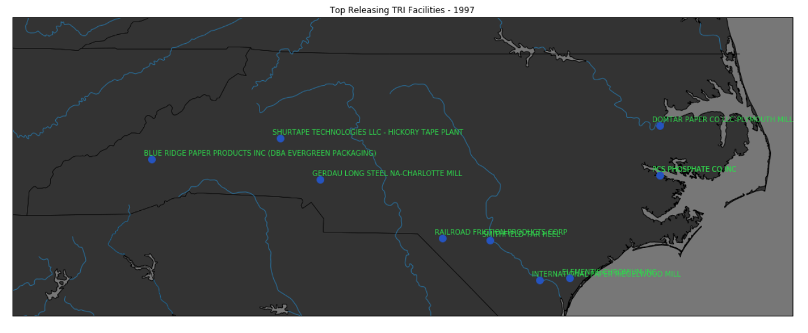
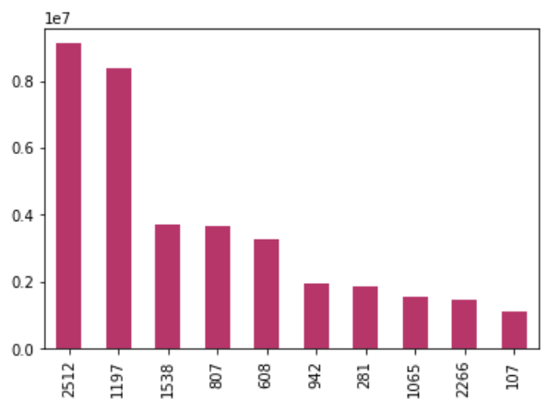
Top Releasing NC Facilities
Top Ten - 1997
In 1997, the top 10 releasing facilities were owned by different parent companies all around the state.

Slide 13
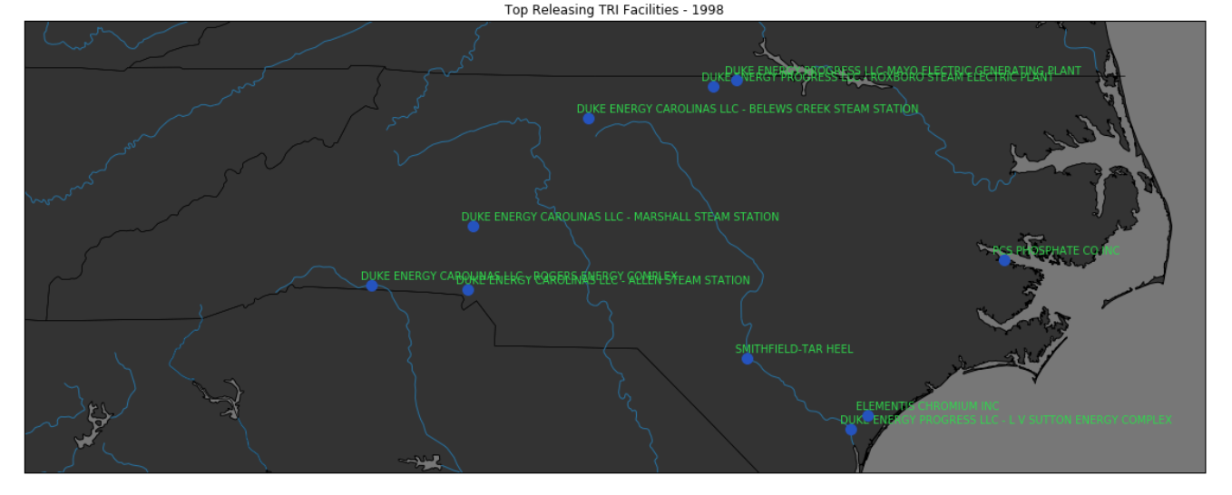
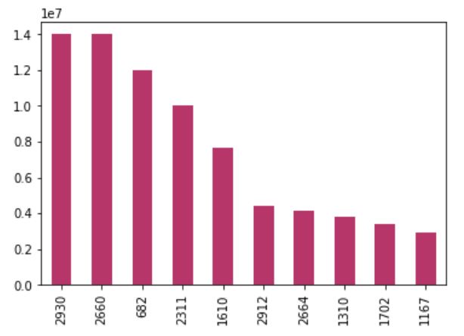
Top Releasing NC Facilities
Top Ten - 1998
In one year, Duke Energy suddenly becomes the top releasing facility in NC, with 7 of the top 10 facilities!
This trend has continued, and Duke remains the top releasing facility in the state by a wide margin.

Slide 14
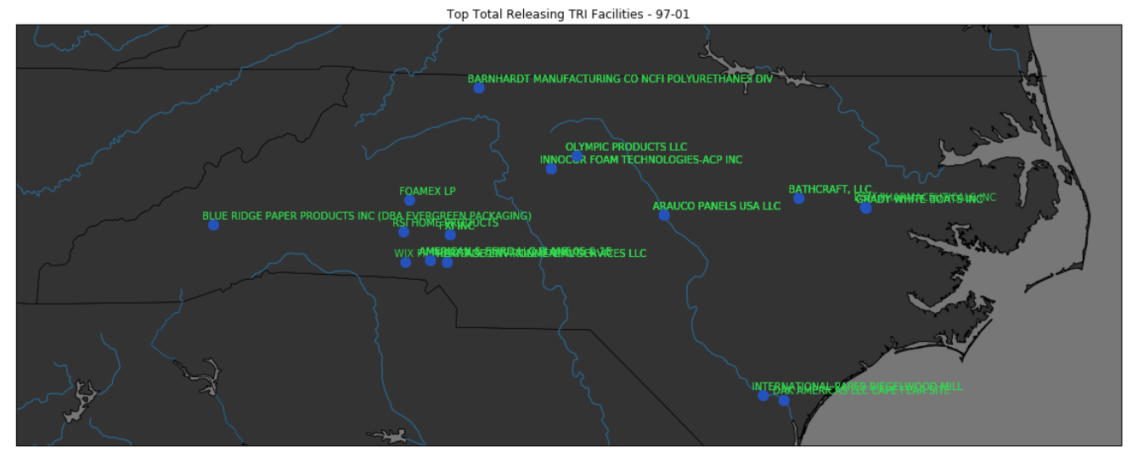
Top Releasing NC Facilities
Carcinogens
Here, we see that Charlotte, one of the most populated cities in NC, is surrounded with six of the top 15 carcinogenic releasing facilities.

Slide 15
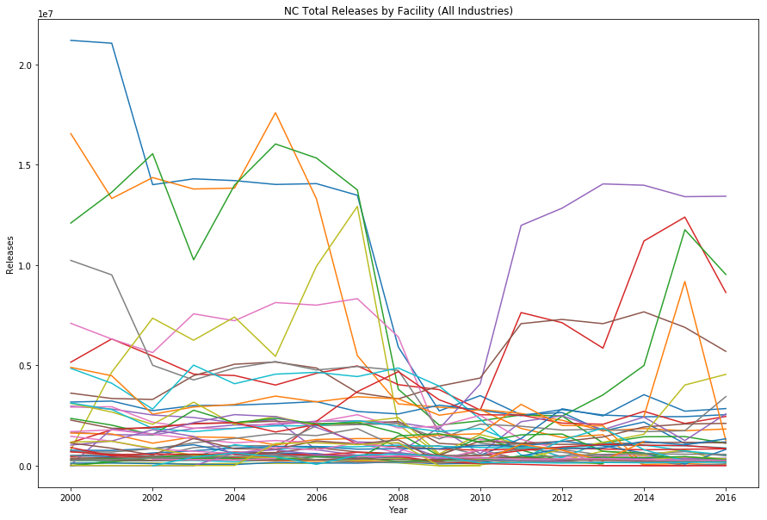
Releases by Facility
2000-2016

Slide 16
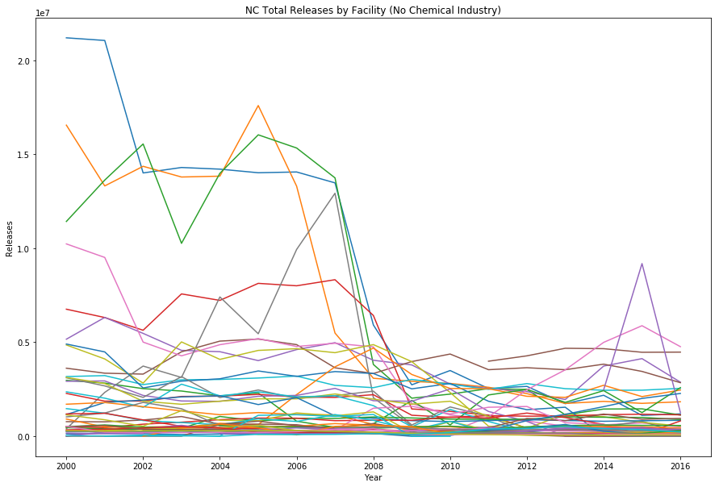
Releases by Facility (No Chemical)
2000-2016

Slide 17
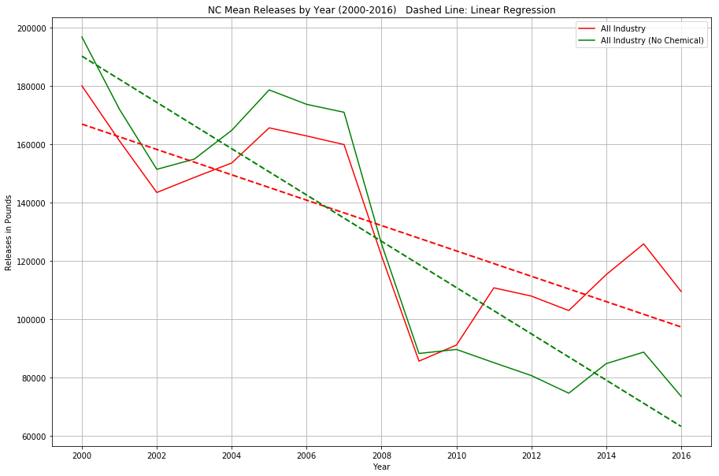
Comparing Release Totals
2000-2016

Slide 18
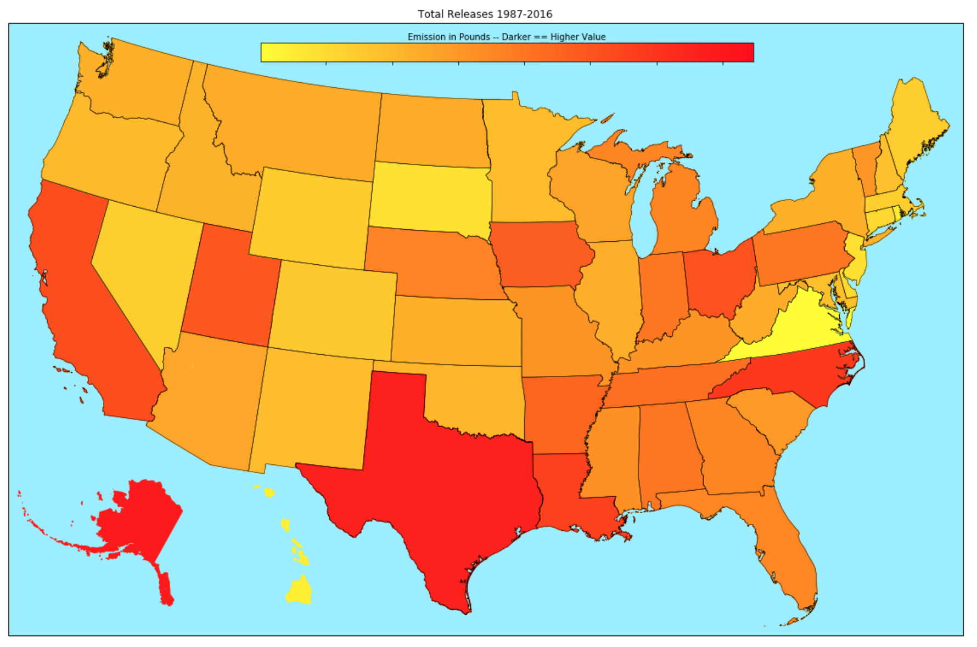
Total US Waste Releases 1987-2016
Top Ten Facilities(N*1+e09 lbs):
^{Alaska - 12.98}
^{Texas - 11.75}
^{Nevada - 9.18}
^{Louisiana - 8.46}
^{California - 7.35}
^{Ohio - 6.95}
^{Utah - 6.47}
^{Indiana - 6.11}
^{Arizona - 5.45}
^{Tennessee - 4.75}

Slide 19
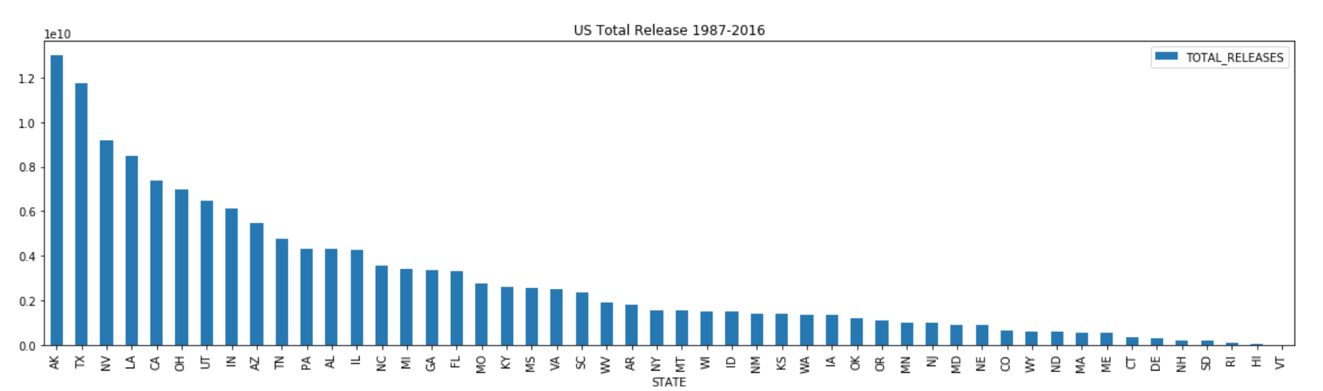
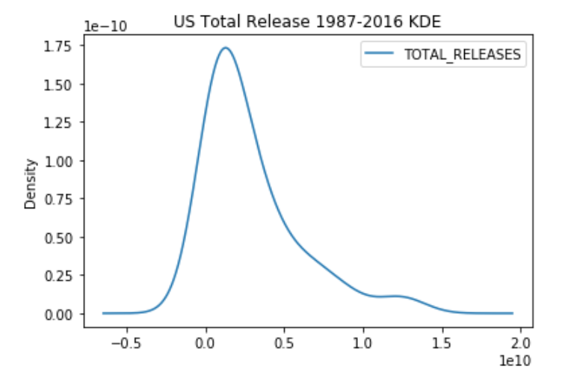
Total US Waste Releases 1987-2016

Slide 20
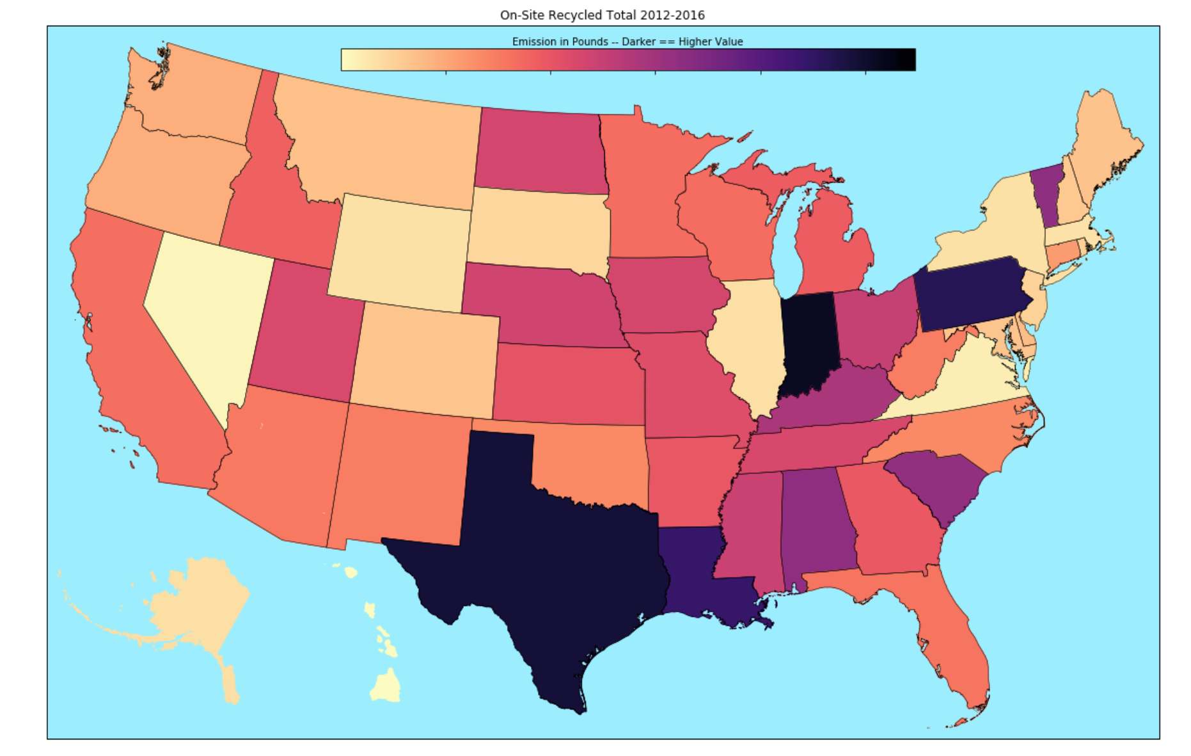
Total US On-Site Recycling 1987-2016
Top Ten Facilities(N*1+e09 lbs):
Illinois - 23.81
Texas - 22.04
^{Pennsylvania - 19.85}
^{Louisiana - 18.00}
^{Virginia - 9.77}
^{Alabama - 9.58}
^{South Carolina - 9.34}
^{Kentucky - 7.46}
^{Ohio - 5.63}
^{Montana - 5.51}

Slide 21
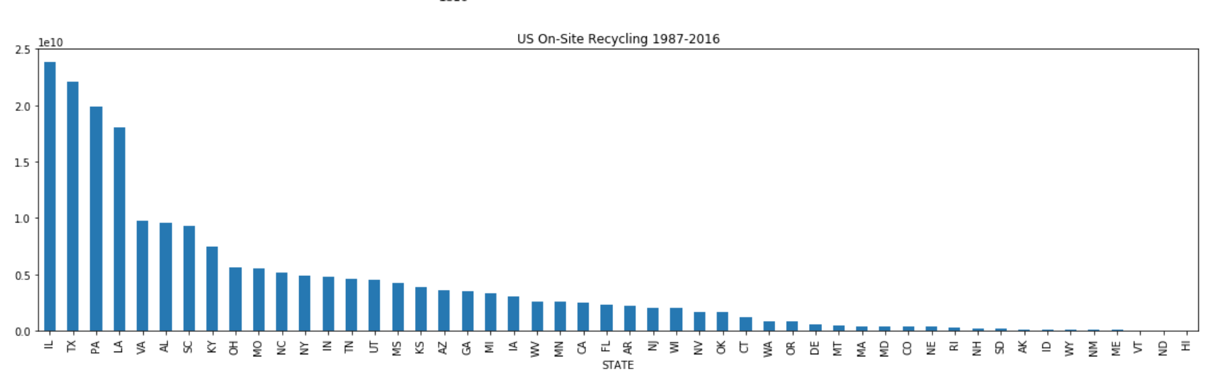
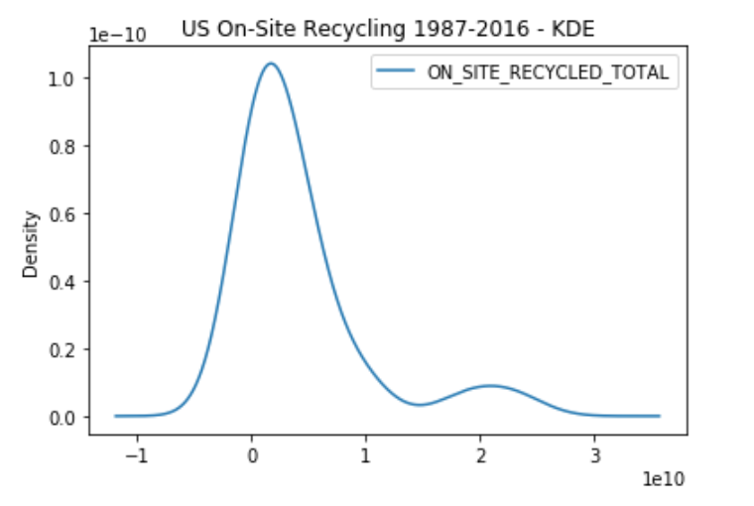
Total US On-Site Recycling 1987-2016

Slide 22
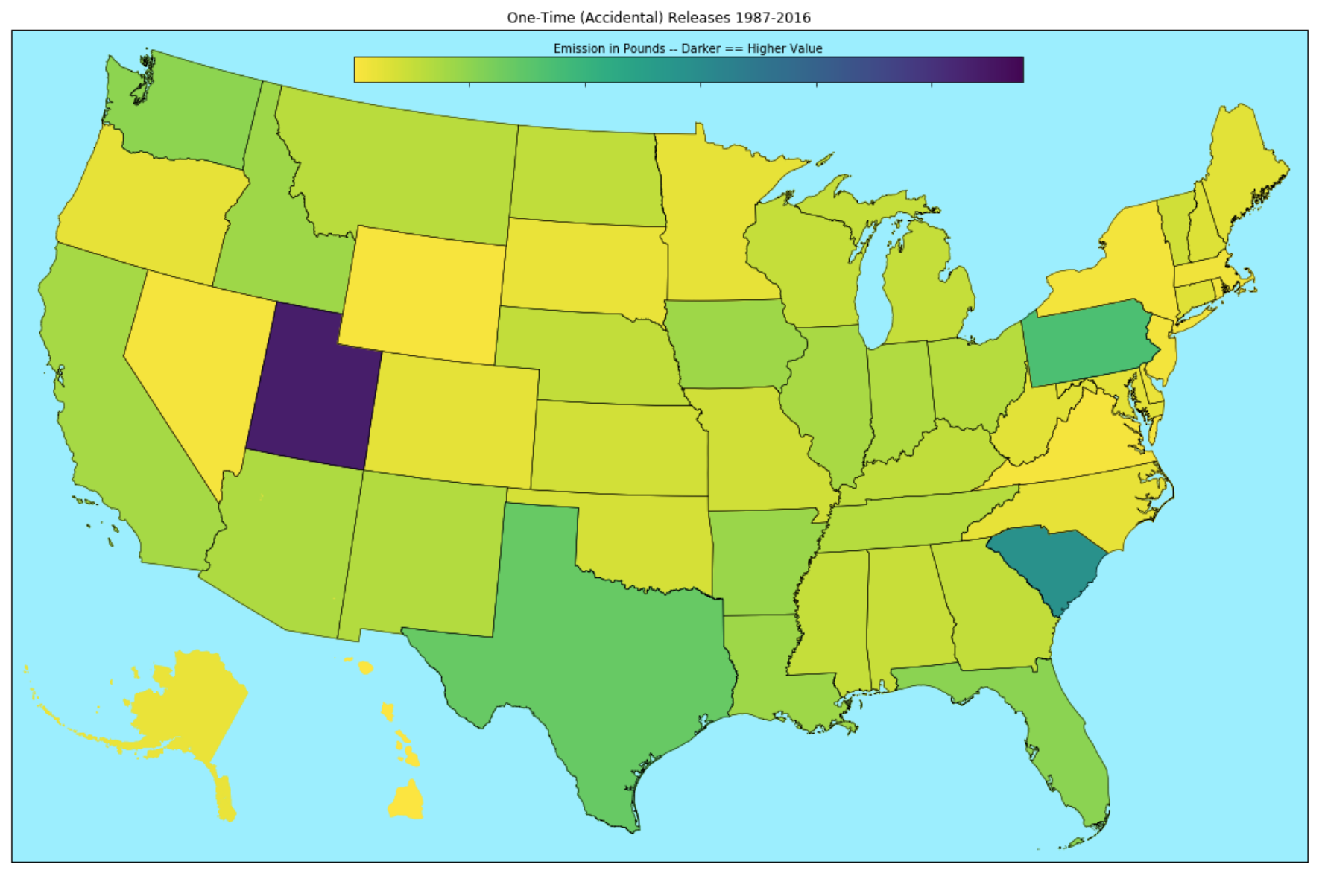
Total US Accidental Release
1987-2016
Top Ten Facilities(N*1+e07 lbs):
Utah - 100.74
^{South Carolina - 28.90}
^{Pennsylvania - 9.96}
^{Texas - 6.73}
^{Florida - 3.67}
^{Washington - 3.58}
^{Arizona - 2.81}
^{Indiana - 2.52}
Iowa - 2.50
^{Louisiana - 2.50}

Slide 23
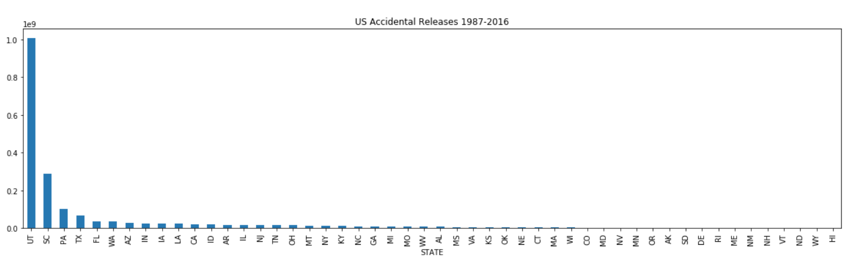
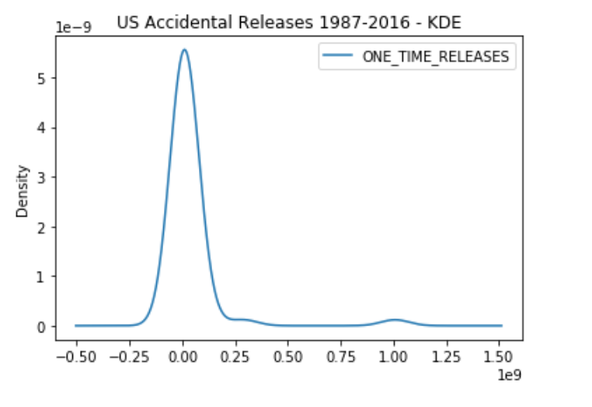
Total US Accidental Release
1987-2016

Slide 24
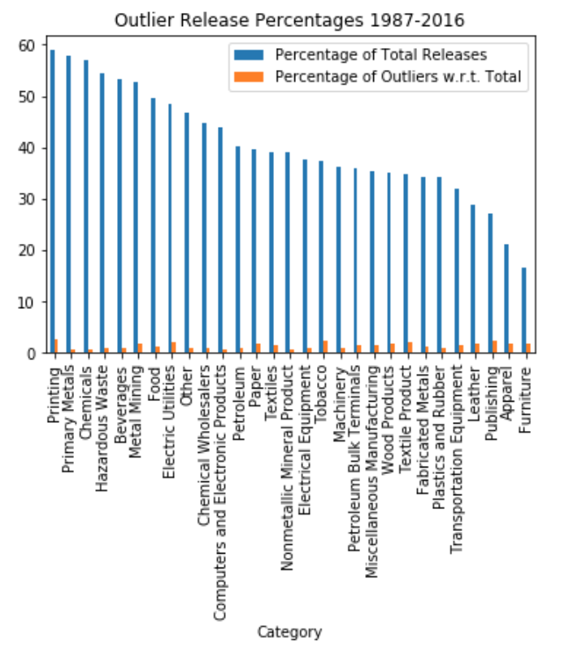
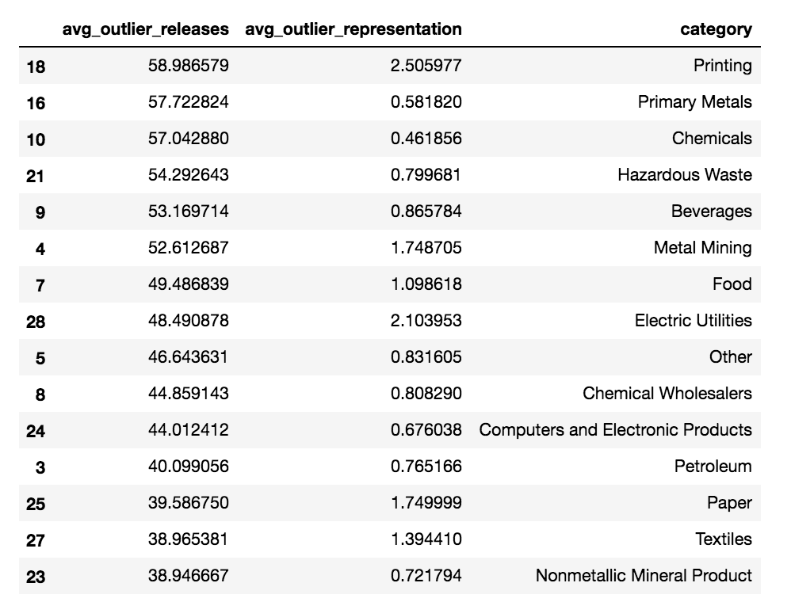
Outliers In TRI Data

Slide 25
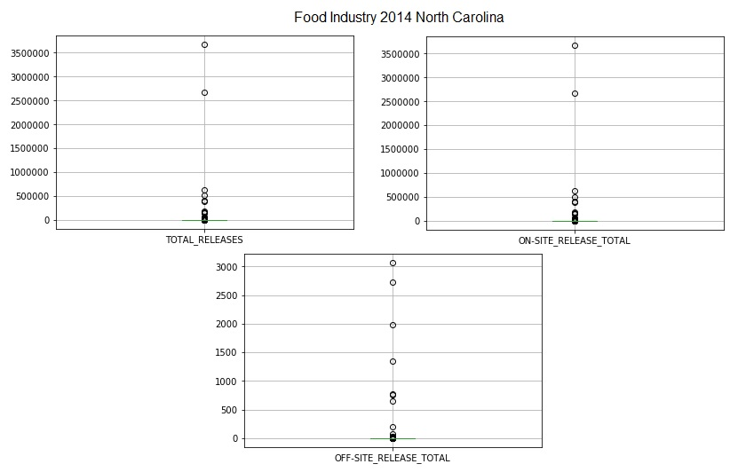
TRI Observations
Observations within the Food Industry Sector
Total releases, On-site releases, and Off-site releases of facilities in North Carolina
Null hypothesis’
Are the Release totals in North Carolina significantly different than the National average?
P values Total release =0.35
On-Site Releases =0.29
Off-Site Releases =1.6 x10^-122

Slide 26
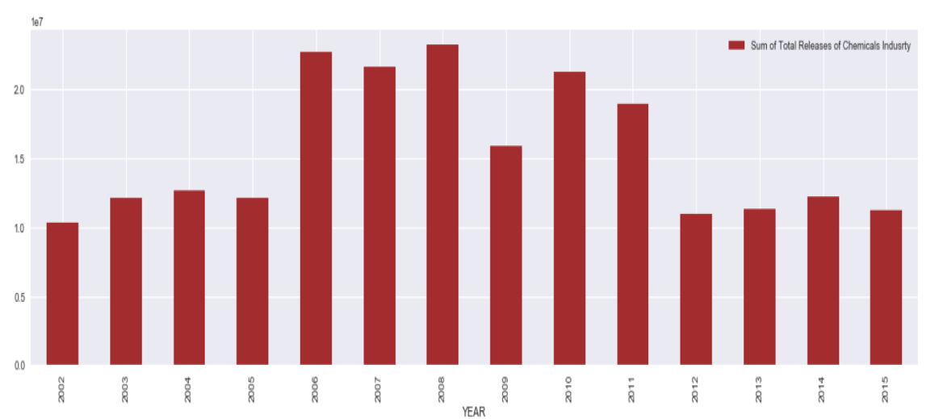
TRI - Zillow Observations
Sum of Total releases of Chemical industries through the years 2002 to 2015 for the state NC is seen as in the plot.
The highest releases were observed in the year 2008 and the minimum releases were seen in the year 2002.

Slide 27
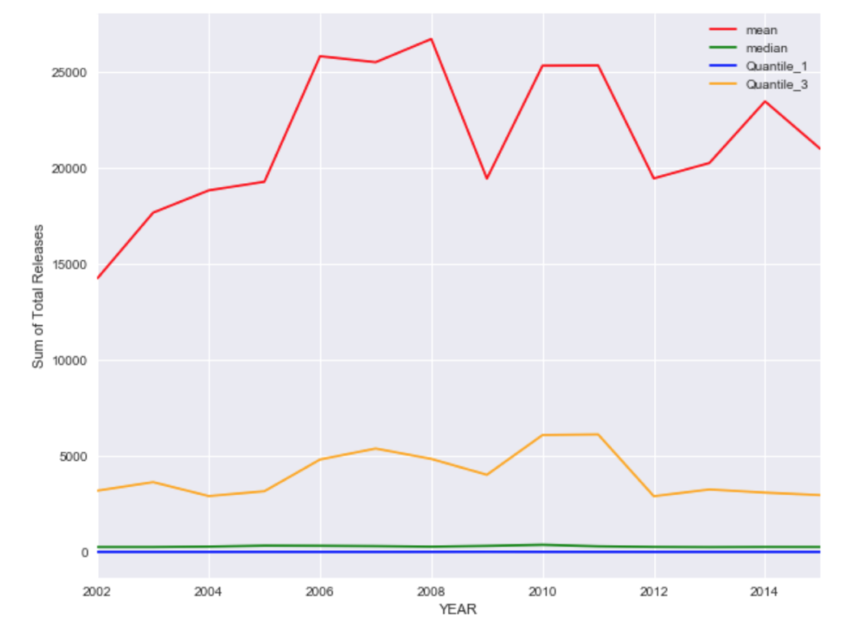
TRI - Zillow Observations
Data shows extremely high divergence.
The first quartile is almost close to zero - 25% of facilities have sum of total releases nearly close to zero
The median is also almost close to zero - 50% of facilities have sum of total releases nearly close to zero
Third quartile shows 75% of facilities have sum of total releases approx ⅓ of the mean value
There are relatively large number of industry facilities that report sum of total releases extremely less compared to the highest toxic releasing industries.

Slide 28
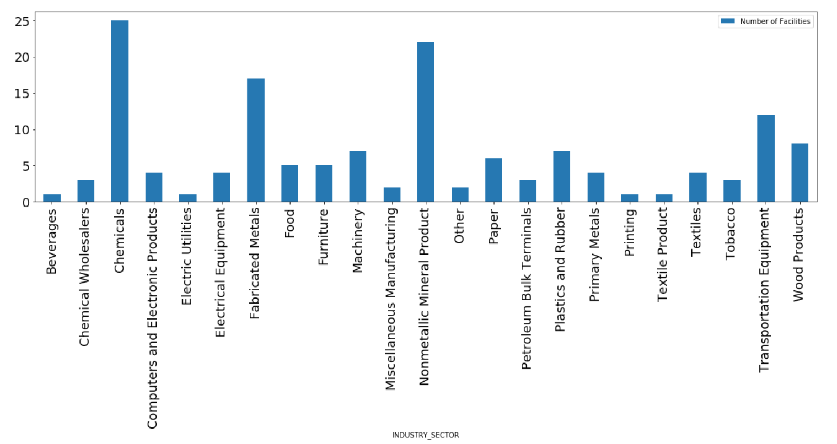
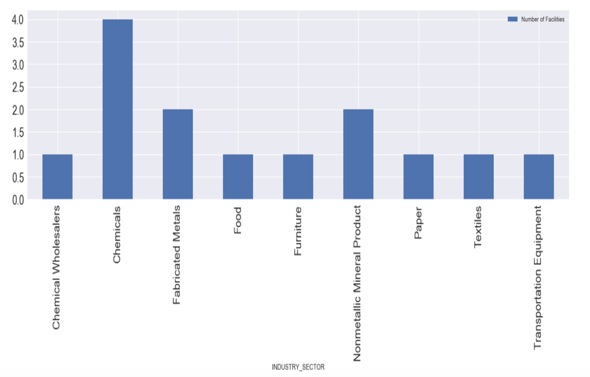
TRI - Zillow Observations
First graph shows the distribution of the count of industry facilities in NC state that have reported to TRI for exceeding threshold Maximum facilities - Chemicals Industries; Minimum facilities - Beverages Industries
Second graph shows the distribution of count of industries within 1 mile radius of centroid.
Maximum facilities - Chemicals Industries

Slide 29
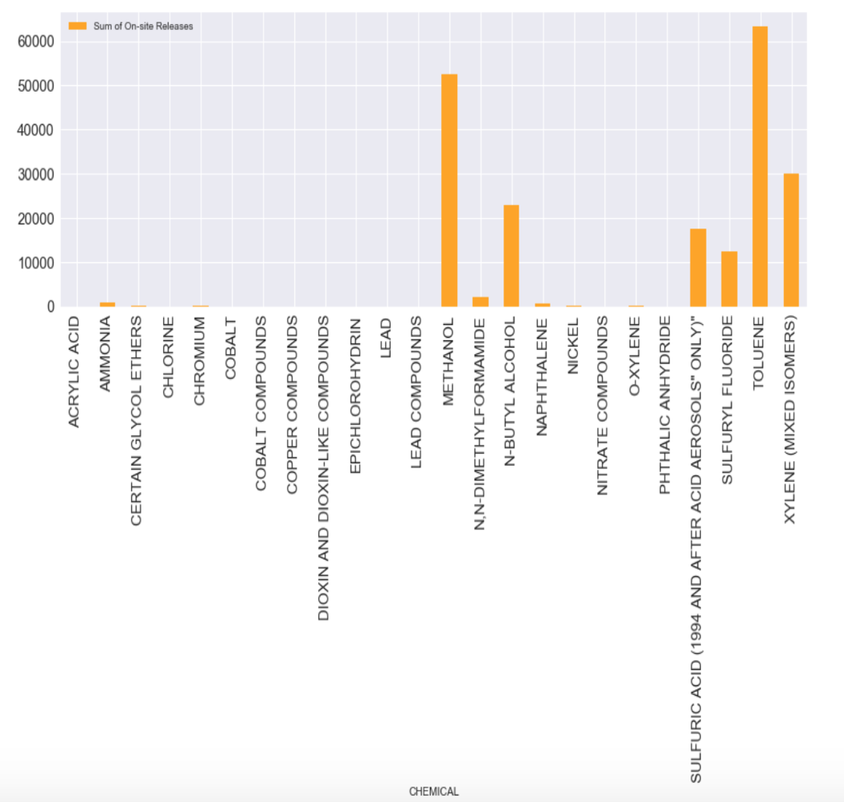
TRI - Zillow Observations
Toxic releases from industries within 1-mile radius grouped by chemicals look as shown in the graph
The highest released chemical within one mile radius is Toulene and the second highest being Methanol

Slide 30
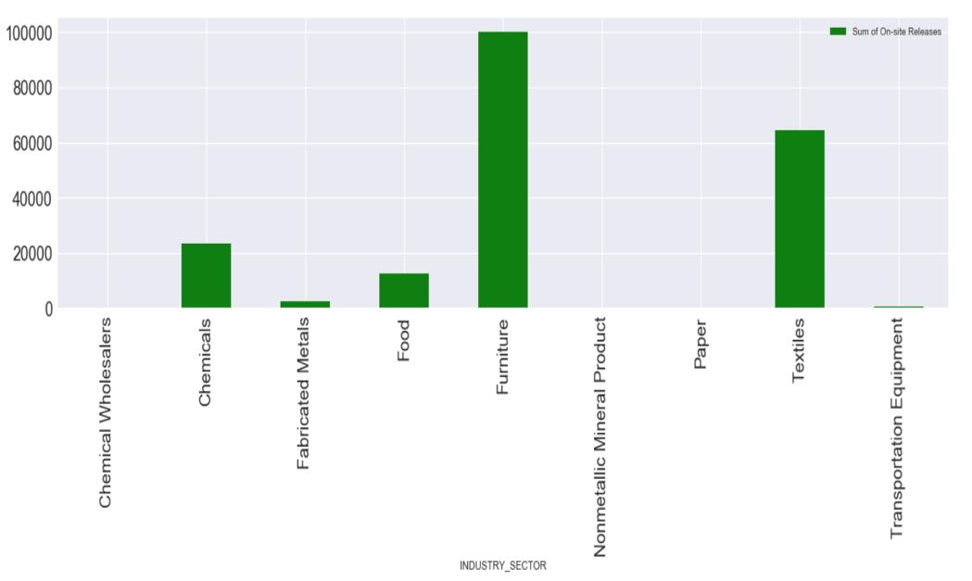
TRI - Zillow Observations
Toxic releases from industries within one mile radius grouped by industry sectors look as shown in the graph
Despite there being more number of chemical industries within one mile radius, the highest toxic releases are observed from Furniture industry

Slide 31
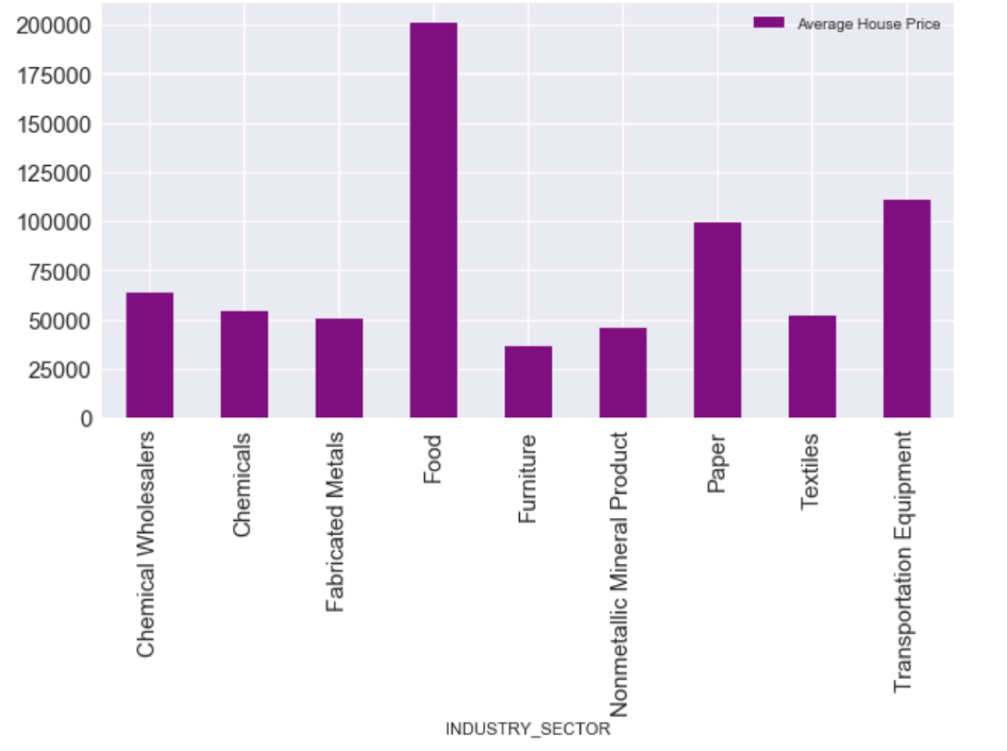
TRI - Zillow Observations
The house prices around the Furniture industry (highest toxic releases observed) sector is the least when compared to other industry sectors.
Distance of houses from industries vs house values - Inversely proportional

Slide 32
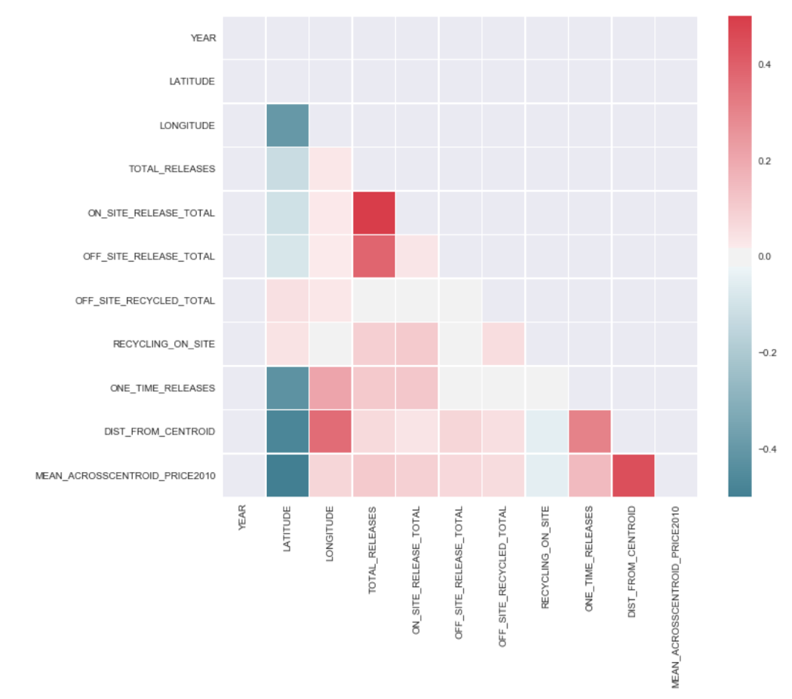
Correlation Analysis
Correlation measures between features of TRI and Zillow are seen.
ON_SITE_RELEASE_TOTAL and OFF_SITE_RELEASE_TOTAL have a relatively high measure of correlation with TOTAL_RELEASES
DIST_FROM_CENTROID has a correlation with MEAN prices across centroid.

Slide 33
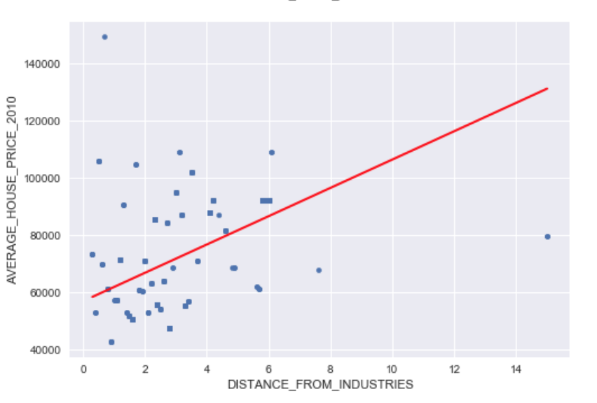
Linear Regression Analysis
Null Hypothesis - There is no relationship between the proximity of houses from industries to the house prices
The p-value was found extremely low value which is less than 0.05. Null hypothesis is rejected.
As shown in the plot, the data TRI - Zillow, for features - Distance of houses from centroid and mean of house prices for each year are plotted
The R-square value is very low, in this case 0.20
There seems to be a positive correlation between the two features.

Slide 34
Thank You.

